Slide 1
Other Characteristics of the NK Landscape
Have we been walking on the moon?
Jon Atwell
Assistant Professor
Organizational Behavior, Stanford GSB
8/6/2020
Notes:
Thank you.
First, I’d like to say I really appreciate the opportunity to present to this audience because I think most of you know the NK model and have the accumulated knowledge to tell me if or where I'm going astray. And I might well be; I am a newcomer to the use of the NK model in theorizing organizational search and learning, having just escape the dungeons of sociology.

Slide 2



Thanks
Adrian Apaza
PhD Student
Stanford GSB
Sara Abdali
Mathematical and Computational Science
Stanford University
Notes:
Before I continue I'd like to thank
i)Adrian Apaza, a Stanford GSB graduate student who has been a huge help on this project
i)) Sara Abdali, a Stanford M and CS undergraduate student who has also been helping on this project.
In spite of that wonderful help, progress on this project has suffered in the pandemic and what I have
today is only the polemical setup, and not the results of the modeling and the human-subject experiment we're in the process of implementing.

Slide 3
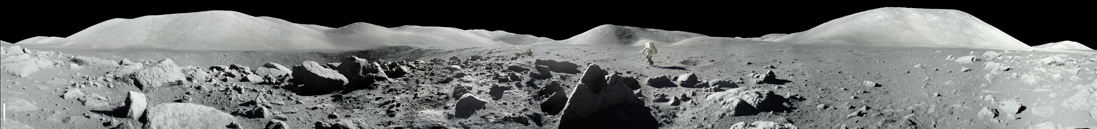
Walking on the moon?
Notes:
But, to that polemic:
The study of landscape models does two things: First, and the primary reason for its extensive use in the management literature, is that it provides a substrate to theorize about search behavior. Early work focused on limited or naive search heuristics, but later work has really started to elaborate richer cognition and behavior. The bulk of the management literature on the NK model focuses on this aspect because that is ultimately what we care about.
The second thing NK models do is describe a problem space and at its core, the NK model is a statement about a problem space. It was introduced to help clarify evolutionary processes in genetics by shifting attention from the processes of genetic recombination and mutation, that is search processes, to the potential fitness outcomes of those changes and the broader structure of the problem. Of particular interest to Kauffman as he articulated the model are the interdependencies between various genes and the phenotypic expression of those genes in the whole organism to which evolutionary fitness is finally ascribed. So interdependence between genes or characteristics is key in structure of the problem he describes.
Management research has good reason to be interested in the consequences of interdependence and that make the NK model a useful tool. There are other features to be concerned with, so there other models too. For example, the surge in interest in multi-armed bandits is exciting.
But I’ve been asking myself for the last 6 months whether the agents in NK are walking on the moon [CLICK], a foreign landscape with little resemblance to the world we live in terms of the problem we encounter. Incidentally, high K NK models look like the surface of the moon in the foreground of this image.
Unfortunately, however, an insufficient amount of work has been done to understand the general features of the problem spaces created by the model.
I'd like to draw attention to a potentially problematic feature of the NK specification that, to the best of my knowledge, hasn't been raised in the management literature.

Slide 4
Shortest-ever NK tutorial?
Notes:
Before I get to my nature of my concerns:
What I actually study is the creation of shared understandings, so I rarely assume common knowledge and while I think this group understands NK models better than almost any other group, I’m going to spend 2 minutes summarizing the structure of model because having that in mind should help make it clearer what my worry is. [NEXT]

Slide 5
N – number of bits in a combinatorical structure
N = 10
{0, 0, 1, 1, 0, 1, 0, 1, 0, 0}
0
Count of elements is 2^{N}
2¹⁰= 1024
Notes:
The N in NK comes from the underlying combinatorical problem.
In this combinatorical problem, N is a number of bits, binary digits, that can be changed. (CLICK)
Let's say N = 10. We can change the bits (CLICK) to get a new combination. When N=10, there are roughly 1000 combinations, so this quickly grows.
(CLICK) Thinking about the combinatorical structure as a vector of bits is good, but I prefer to think of it as a hypercube. [NEXT]

Slide 6
As a hypercube (for N=3)
(0,1,1)
(1,1,1)
(0,0,1)
(1,0,1)
(0,1,0)
(1,1,0)
(0,0,0)
(1,0,0)
Notes:
In which the vertices correspond to the elements and the existence of an edge indicates a distance of 1 between the elements. This is the N equals 3 hypercube for ease of visualization. All vertices have 3 unique neighbors. I like thinking about the structure this way because [NEXT]

Slide 7
(0, 1, 1)
1
(1, 1, 1)
X, Y, Z
start = (1, 0, 1)
1
0
1
(1, 0, 1)
Z
step 1 = (1, 1, 1)
0
step 2 = (0, 1, 1)
0
(0, 1, 0)
end = (0, 1, 0)
Y
X
Notes:
It helps me accurately think about movement in the underlying geometry. So here is a traversal of edges and vertices from (1,0,1) [CLICK] to (0,1,0). This is setup is kinda cool, but also kinda boring until you turn it into a combinatorical /optimization/ problem.

Slide 8
Combinatorical optimization
1
1
0
Notes:
To make it an optimization problem, you just assign each vertex a payoff or fitness value. Here fitness is visualized through the size of vertex. Then you can start thinking about [CLICK] how a process of optimization might proceed. Now all of this is quite old and not yet Kauffman’s NK model.

Slide 9
Local optima
Global optimum
Notes:
Kauffman’s NK model starts with the combinatorical structure and the notion of a fitness landscape i just described to explore the consequences of interdependence between bits in terms of overall fitness. I'll return to how that is done shortly, but an important outcome of how it is done is that increasing the interdependence increases the feature known as ruggedness, which is the just the count of local optima. The cognitive implication of this feature is that it’s hard for myopic or boundedly rational actors to get from an inferior optimum to better vertices/combinations because we likely have to accept worse outcomes in the course of search. Getting from this local optimum [CLICK] to the global optimum [CLICK] requires either full knowledge of the landscape, tremendous luck or traversing vertices with lower fitness. From the current optimum, any traversal requires visiting a point with a lower fitness. [CLICK] That's why it's a local optimum.
The results of formal models and lab-experiments done on NK landscapes largely correspond to these intuitions.

Slide 10
1
1
0
0
1
0 0 0 ~ U[0,1]
0 0 1 ~ U[0,1]
0 1 0 ~ U[0,1]
0 1 1 ~ U[0,1]
1 0 0 ~ U[0,1]
1 0 1 ~ U[0,1]
1 1 0 ~ U[0,1]
1 1 1 ~ U[0,1]
Notes:
This ruggedness is a consequence of how fitness values are calculated.
Let’s start with N = 5 and say K=2. Saying K =2 means that the fitness contribution of a single bit depends of the current status of two other bits.
Let’s say we’re going to change this the second bit, currently 1 [CLICK]. Let’s also say it depends on the next two bits [CLICK].
To get the fitness contribution of the second bit given interdependence, Kauffman stipulates we should look at the combinations of the three bits.
Each combination gets a fitness contribution that is a drawn uniform at random between 0 and 1.
For each bit, you look up the fitness contribution of each according to which is actually present and then average them.
As K gets larger, the change of a single bit requires looking up more combinations and that means more random draws so by the central limit theorem this converges to .5 as K goes to infinity.
That’s the model in 120 seconds.

Slide 11
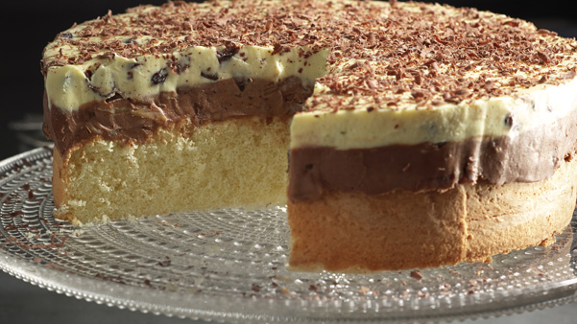
Rose Levy Beranbaum’s Polish Princess Cake
Why?
Notes:
So back to the use of NKs and what might be problematic with the model.
The reason I want to revisit the details of the NK model is Theorizing search in a problem space that doesn't have the features we want is like trying to understand how to bake a cake by practicing in a microwave. You can get the ingredients just right for the oven (here the ingredients are the cognitive and social processes related to search and the oven is a real domain), but if your batter ends up in the microwave, you're going to make the wrong inferences pull out a thick, rubbery pancake instead of an airy cake. [CLICK].

Slide 12
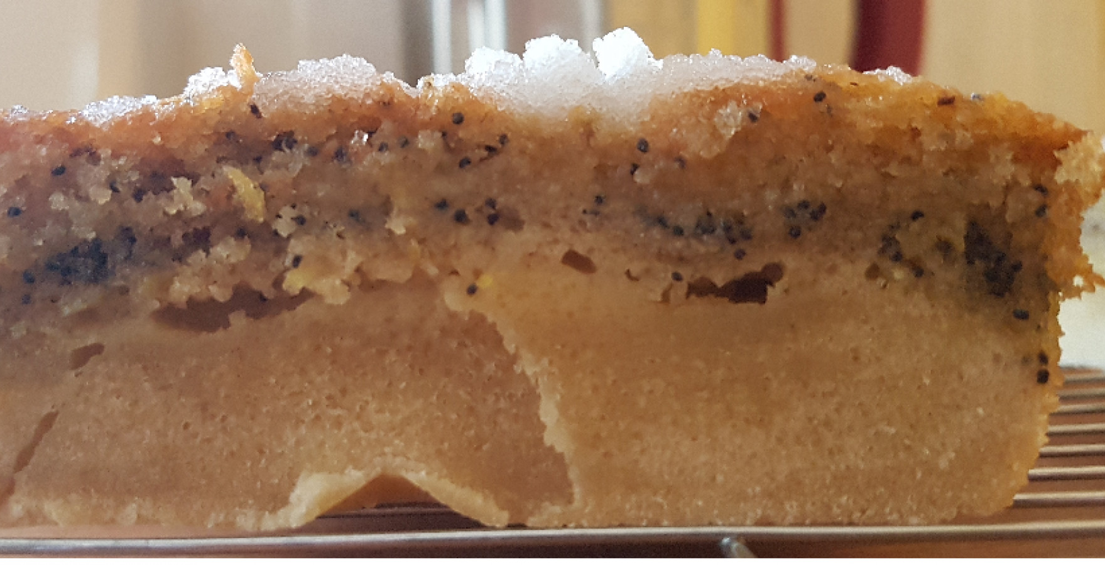
Notes:
This isn’t to say you don’t learn something from baking in a microwave, but you can’t seamlessly transfer knowledge about the oven to the microwave or vise-versa.
The outcomes of search, and therefore also the dynamics, are inextricably coupled to the features of the problem space so we have to be careful about the transferability of insights about search made on one type of landscape to another type of landscape.

Slide 13
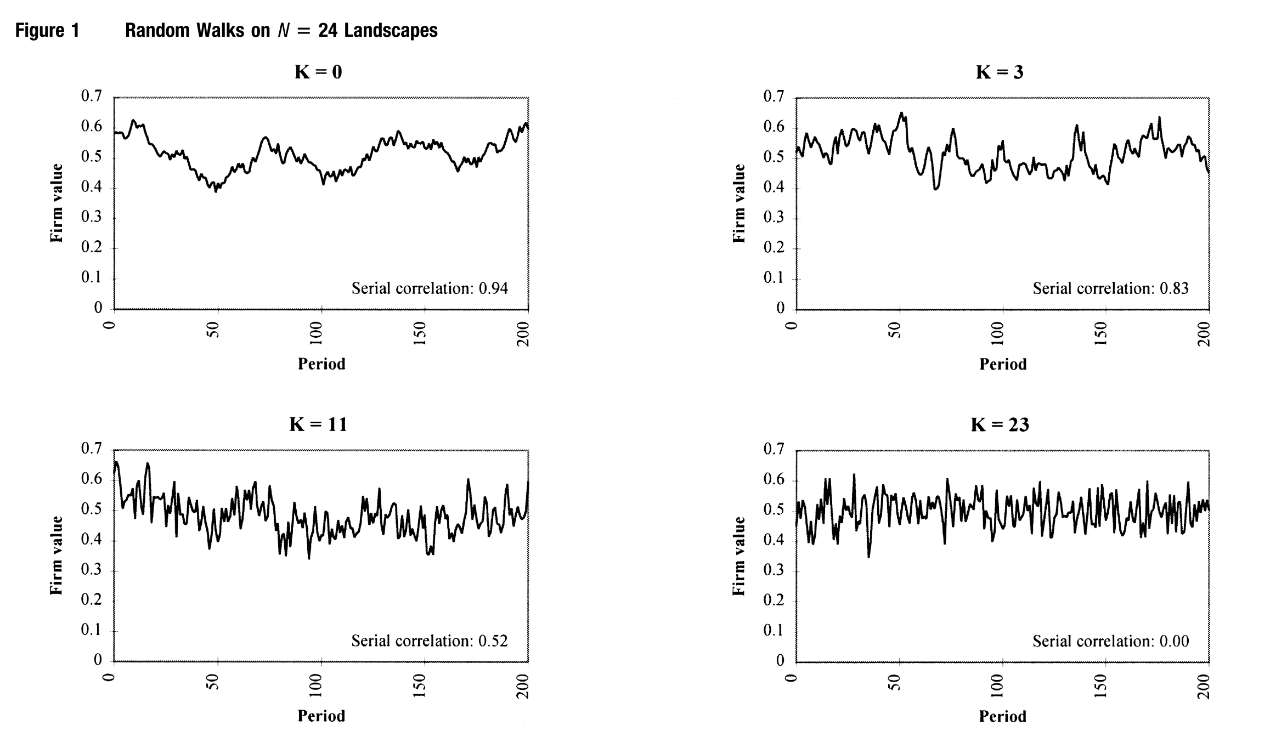

Rivkin, 2000: Imitation of Complex Strategies
Notes:
My core claim is that the NK model does a great job capturing one specific feature that is desirable, that is ruggedness, but tuning K also varies other feature of landscape with relevance to search.
The other feature I'm most concerned about is the macroscopic curvature of the landscape. K tunes the microscopic shape of the landscape in a theoretically interesting way, [CLICK]
– you can see this in the lower right by this blue bar in Figure 1 from Rivkin’s 2000 MGMT SCI paper on the imitation of complex strategies that there are many local optima and larger jumps in fitness.
But it also tunes the macroscopic features in problematic ways. Namely, it flattens the whole thing. [CLICK]
Compare the lower right to the upper left by the pink bar. It looks like a terrestrial mountain range [CLICK], not a lunar rock field [CLICK]
A couple things to say now…first, these are plots of random walks, meaning you are not seeing a cross–section of a landscape like in the pictures, but rather a very strange trajectory. I think the use of plots like these cause a lot of confusion and obfuscate the macroscopic structures. That said, there is no denying the global flatness in the lower right.
Second point is that agents in models and human subjects do a really good job searching in the upper left and a bad job in the lower right. In the literature, this is attributed to the ruggedness of the lower right, but I think it’s fair to ask if the cause of that performance decline is about ruggedness or the fundamental change of the landscape from one with global curvature to one without.

Slide 14
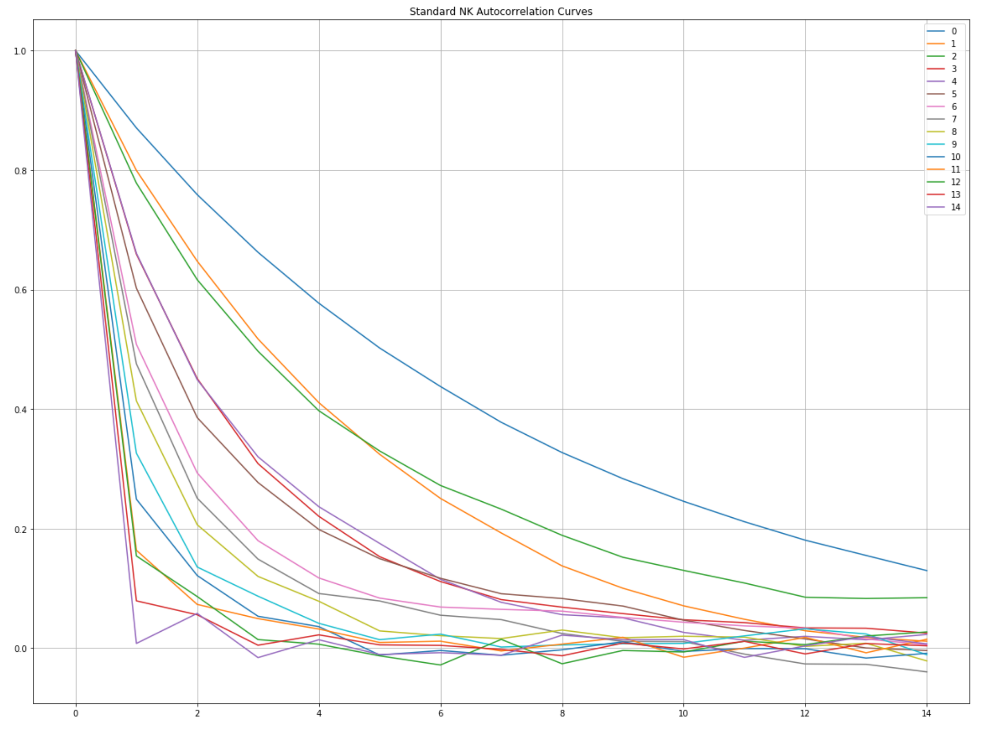
Weinberger, 1990
Notes:
In the mathematical literature this flattening is known feature of the model. Increasing K contracts the variance in fitness values and thereby reduces correlation distances, that is the correlations in fitness values between points a given distance from each other on the hypercube. That's why low K models are sometimes called correlated fitness landscapes and high K models, uncorrelated landscapes.
This plot shows the Weinberger correlation distance measure for an N=15 model. I realize seeing this on Zoom is hard so I'll describe it. The blue line on the top is K=0 and the lines are very nearly increasing in K as you go toward down toward the origin.
The correlation distance is really a measure of mutual information; how much information does the fitness at one point reveal about neighboring points. The answer as K increases is almost nothing. When K=0, you can take 5 random steps and still have your fitness value have .5 correlation with the point you left. When K=N/2, in two steps you've down to a correlation of roughly .2. For higher K, you lose almost all information as soon as you move.
I think it’s highly unlikely that there are many problems in which changing one or two characteristics leads to outcomes completely uncorrelated with the initial feature set. That’s not to say, you can’t make changes that blow everything up, but that isn’t the case on average and correlation distances look at the whole neighborhood.

Slide 15
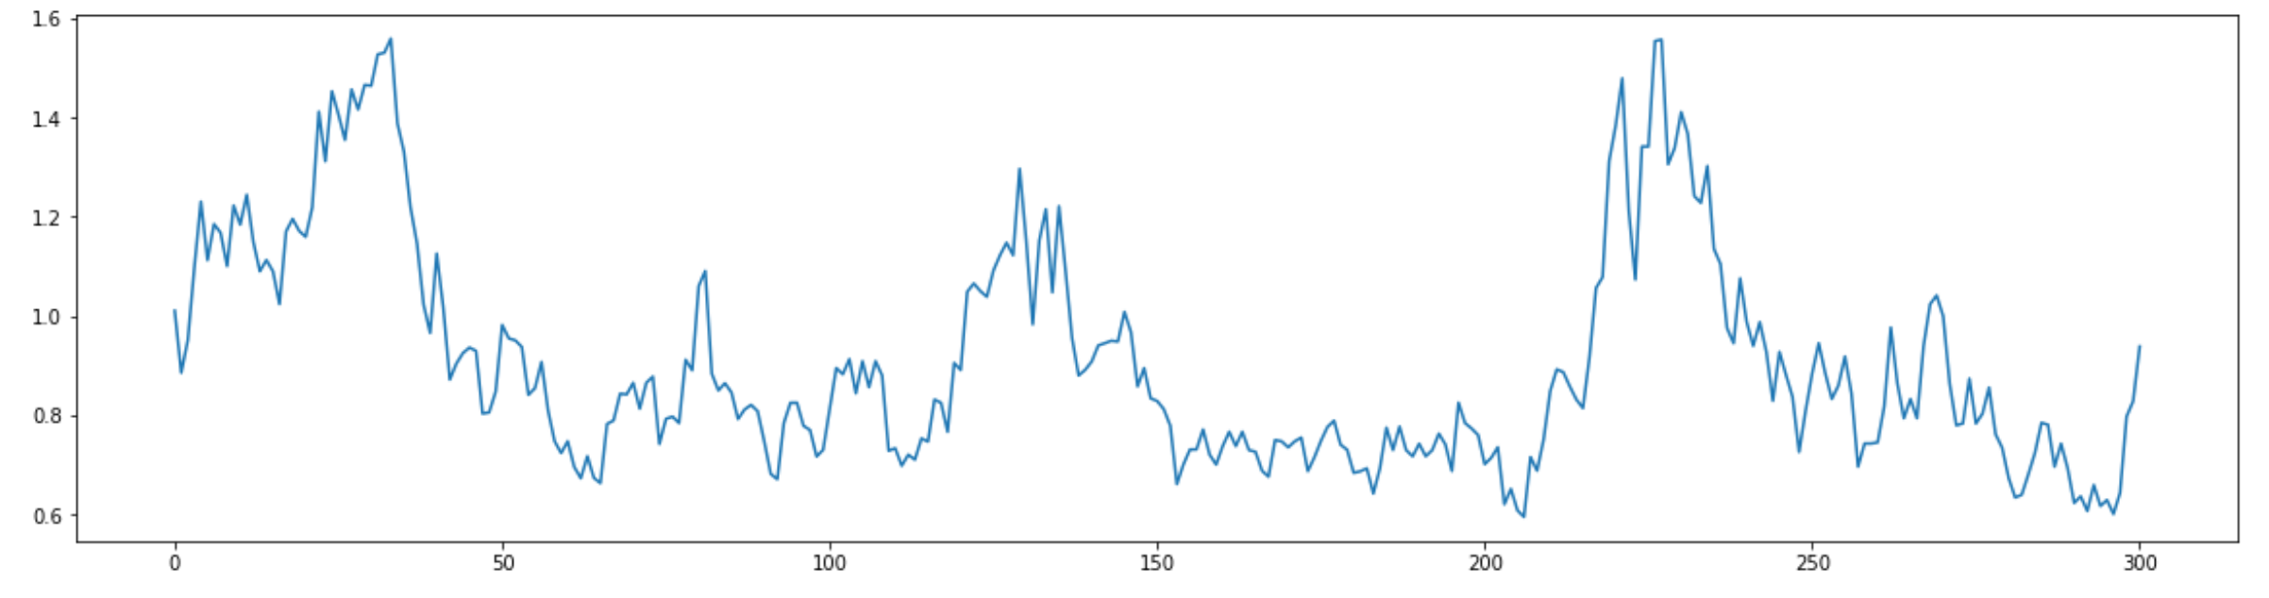
The separability of ruggedness and correlation distance
Notes:
So we know correlation distance is affected by tuning K, but should we really care?
YES, because ruggedness and correlation distance should be separable. [CLICK] It’s not hard to imagine a landscape that has plenty of local ruggedness that has the mountainous topology that gives rise to correlation across distances.
And if they are in fact separable but always linked for mid to high K in the NK model, then we can’t tell if ruggedness is the impediment to search or the lack of mutual information (or something like this.) Separating ruggedness from the other features of the landscape is my goal here because if ruggedness is not the cause, it has implications for how we think about search processes.

Slide 16
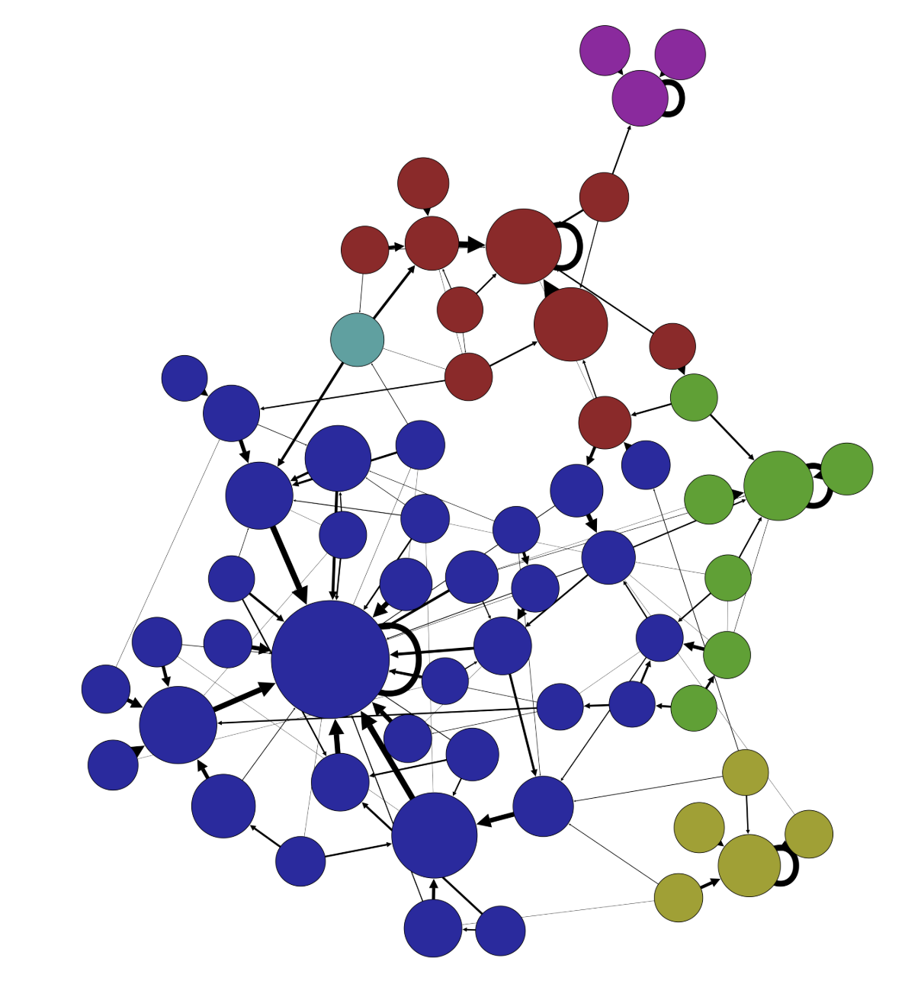
So what does the global curvature look like?
LOCAL OPTIMA NETWORKS
(Doye 2002, Ochoa et al. 2008, Herrman et al 2016)
Herrman et al 2016
Notes:
But I’ve actually gotten a bit ahead of myself because correlation distance is just one lens with which to view the landscapes, and per Proust and Gallo, different lens can enrich us.
We’ve tried a lot of lens on and I’ll now share just the most promising one. The lens is that of local optima networks or LONs. [CLICK]
A LON characterizes a space by labeling local optima as adjacent in a graph if they are reachable from one another given a, usually conservative, search algorithm. Notably, the edges are weighted by the probablitiy of transition, so you need to run the search algorithm a lot of times, like really a lot to map it out. [CLICK]
Here is an example.
On the resulting network you can then use your preferred flavor of community detection to get clusters of local optima. Here is the LON for an NK with N=20 and K=5. The optima are thresholded for visually clarity to the top 10% in fitness and color coded by cluster.
You can see that for this low K landscape, the global optimum is in the middle of large cluster of other optima with high transition probabilities to the global maximum, making it a strong attractor. But also note that the blue cluster is a significant proportion of the population. So a couple of trials of, here hill climbing with a two-step perterbation off local optima, will almost always find the global max. There is a great big funnel around it.

Slide 17
And for high K?
K | # local optima | # clusters | Global cluster size
5 | 546.9 | 5.285 | .412
10 | 3384.5 | 19.985 | .147
15 | 7957 | 42.101 | .074
Reproduced from Herrman et. al 2016
Notes:
So we want to look at how tuning K changes this structure
Here are some ensemble averages for a few key characteristics
So as expected, increasing K increases the count of local optima.
But it is also increasing the number of clusters.
And most importantly, it is decreasing the size of the cluster containing the global max.
So increasing K has taken a landscape that a large funnel leading to the global max and broken it apart into a bunch of little mounds.

Slide 18
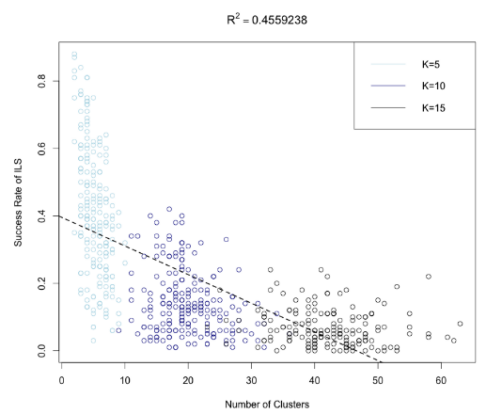
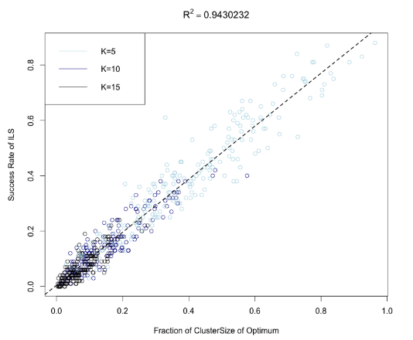
From Herrman et. al 2016
Notes:
This increase in the number of distinct clusters is clearly associated with the ability of the search algorithm to find the global max. [Describe]
But even more compelling is the relationship between the size of cluster containing the global max and the success rate. It is nearly perfectly correlated.
In both panels, the black dots are K=15 and most of them are near the origin in the right panel because increasing k tends to split up the local optima network into lots of distinct and small clusters. However, the larger the global max cluster is, the more successful search is.
To me, this says the cause of bad search outcomes is not the local ruggedness, but the flattening of the landscape into small clusters.
And this matters for more than local search. If you’re doing long jump searches in the high K landscape, you’re unlikely to find the cluster with the global max because it’s so small. You’re likely to land in a comparable cluster.
So at this point, my hypothesis is that it is not ruggedness that determines search otucomes, but rather structure of the clusters. Agents, including humans, aren't necessarily frustrated by some local noise. But search on high K landscapes is a truly frustrating problem on the macro scale.

Slide 19
And next?
Specify a landscape ensemble with separable features
Let human-subjects search on it!
????
Notes:
So where to now.
Working on specifying a model that has local ruggedness and global curvature.
Doing simulation and human-subject experiments.

Slide 20
Thank you!
Jon Atwell
atwell@Stanford.edu

Slide 22
Local optima counts
The primary feature of the environment that is considered
Because of bounded rationality
But there are any number of features of an NK landscape that
Relate to search behavior.

Slide 23
Two Claims: I) Organizational Landscapes do not have complexity catastrophe (have curvature) Structural critique of NKs
2) Human reasoning in search is not limited to local search (behavioral critique of NKs).
About 2 – The NK was proposed with limited search…made sense for the context. But theorizing richer cognitive processes on NKs (instead of a different type) is a like trying to make a spinach and Gruyure souffle in a Taco Bell kitchen.

Slide 24
Combinatorical search
Rivkin and Siggelkow’s paper points out that structured interaction patterns
should matter, but still only looks at the optima.
Total draws from the Uniform distribution = N*2^k+1
Being able to move off local optima is different than having a broad search radius.
When exploration means jumping a distance in space and climbing again, the funnel structure (basins) matters.
From 1 local optima into another doesn’t help much, especially because the size of basin with the global optima
Is shrinking.

